Slide 1
Individual Project
Stephanie Losee
11/11/11

Slide 2
First-Born
I am my parent’s first born child. They struggled for over 7 years with infertility treatments and IVF before becoming pregnant with me.
I am greatly impacted by my sibling status, as well as the planning that went into my birth. I am a first born child, which means I fall into this personality category: “They also tend to be reliable, conscientious and perfectionists who don't like surprises. Although, firstborns are typically aggressive, many are also compliant people pleasers. They are model children who have a strong need for approval from anyone in charge.”
Many people may not know this, but first-born children who are more than 4 years apart from their siblings can also have only-child personality traits, which means: “Only children are firstborns in triplicate. They are even more responsible and even bigger perfectionists. They usually get along better with people older than themselves.”

Slide 3
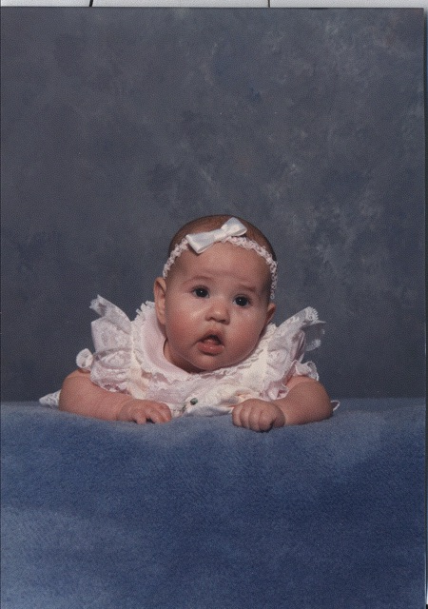
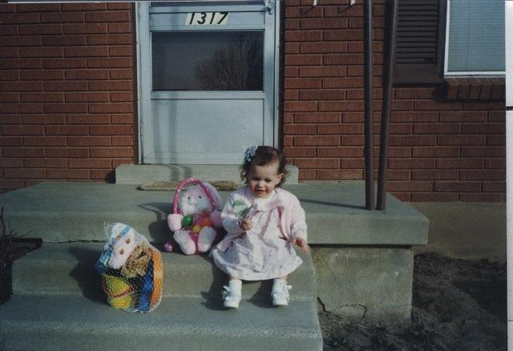

Slide 4
Education
My mother has been amazing. She continually taught me educational things growing up. I was never sat in front of the television or ignored. By 2 ½, I was accepted into Challenger. I loved that school! I was taught to read in preschool, just a few months after I started. I was able to get into ballet, and was years ahead of the public school system. This school helped mold my desire to learn anything and everything I can.

Slide 5


Slide 6
Moving
My parents moved twice during my life, once from Kearns to West Jordan, and once from West Jordan to North Salt Lake. I loved my house each time, but have grown very attached to my home in North Salt Lake, where my parents still live. I feel that it is truly where I belong. My mother’s grandparents actually helped to settle Bountiful. They owned all of the space where the “bubble” used to be, and the rec center now is. In fact, their house still stands just east of the rec center. My roots are in this community and I plan to never move away (again).

Slide 7
My first relationship
I started dating my first boyfriend when I was 15. That was a mistake, but I definitely learned from it. I went as far as to transfer high schools and move out at 17. However, not everything that came from the relationship was negative. We bought this dog that stole my heart and named him Toby. He was an angel on earth. One day, my friend’s (now ex) boyfriend started beating me up. My ex stood there and watched. My dog fought for me. The guy ended up getting a domestic violence charge after I pressed charges and we went to court. I realized then what true love is and how family will always be there for you, but you never see a person’s true colors until it is too late.

Slide 8
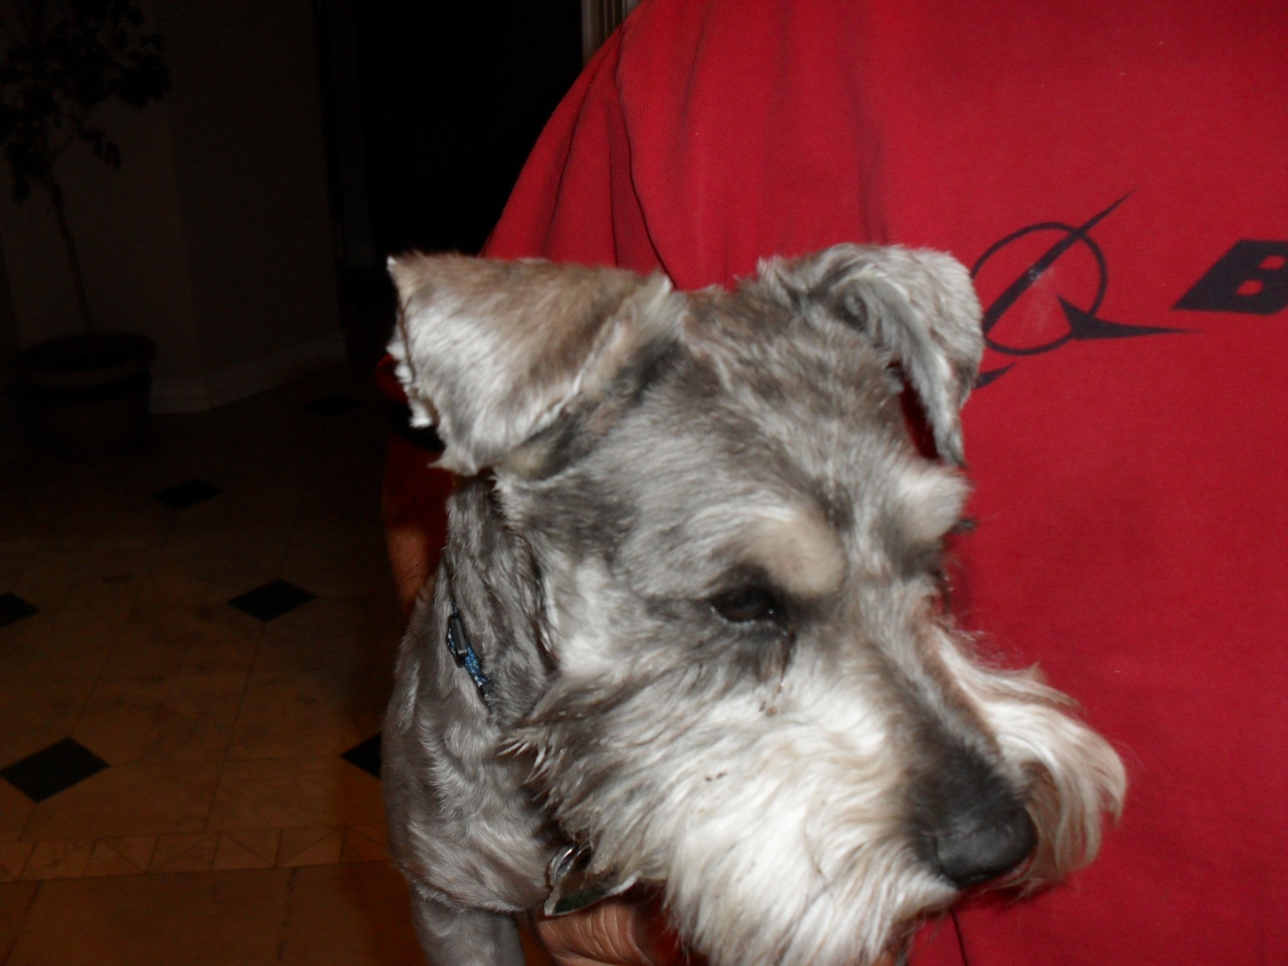

Slide 9
My husband
Meeting my husband was the most amazing point in my life. I had just started a new job and met this man that changed my idea about men. We started dating immediately. Just a year later, we were married and moving into our new house.

Slide 10
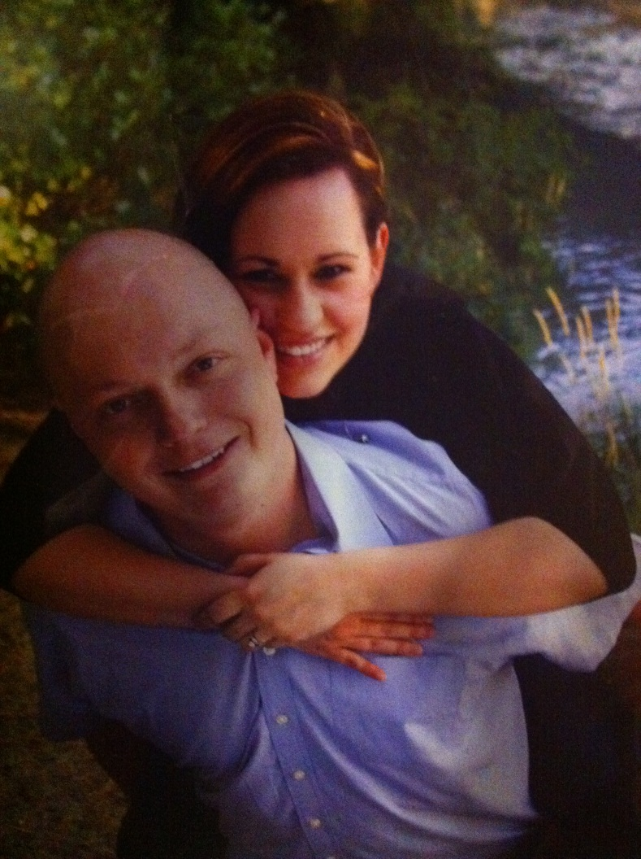
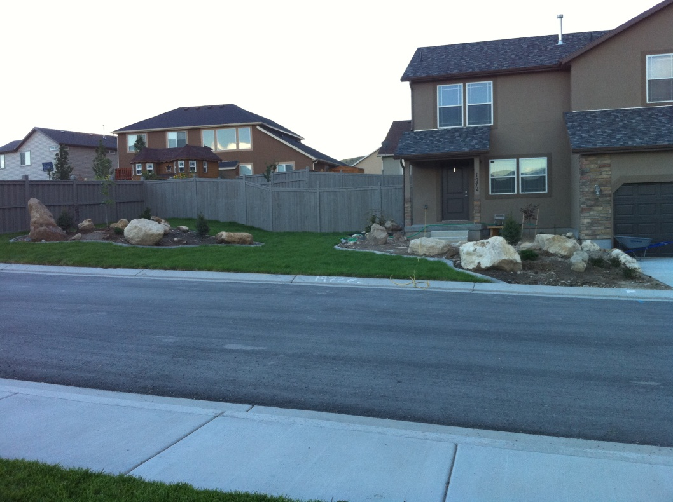
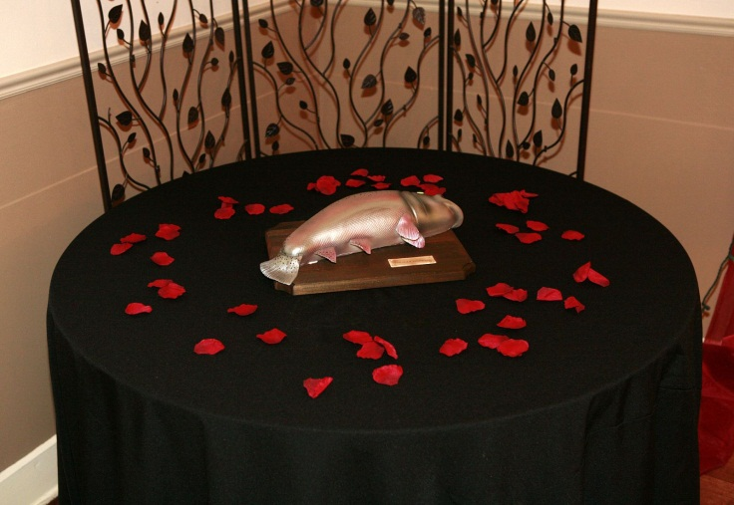
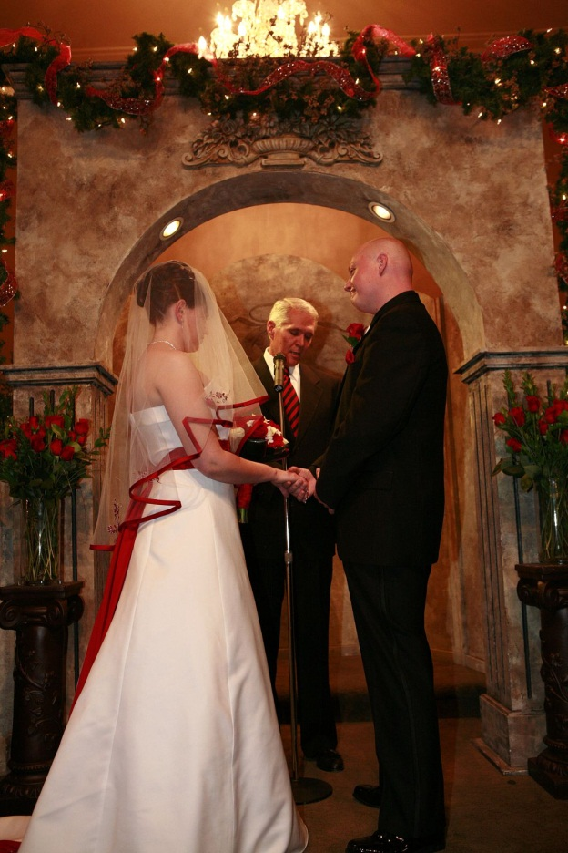
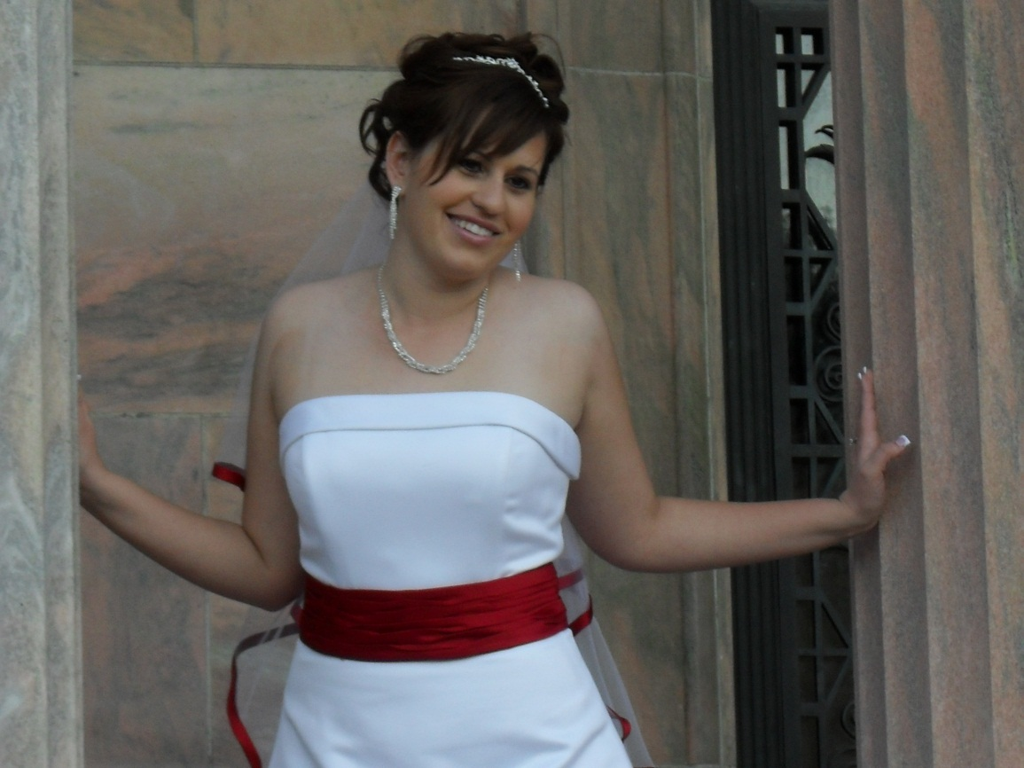
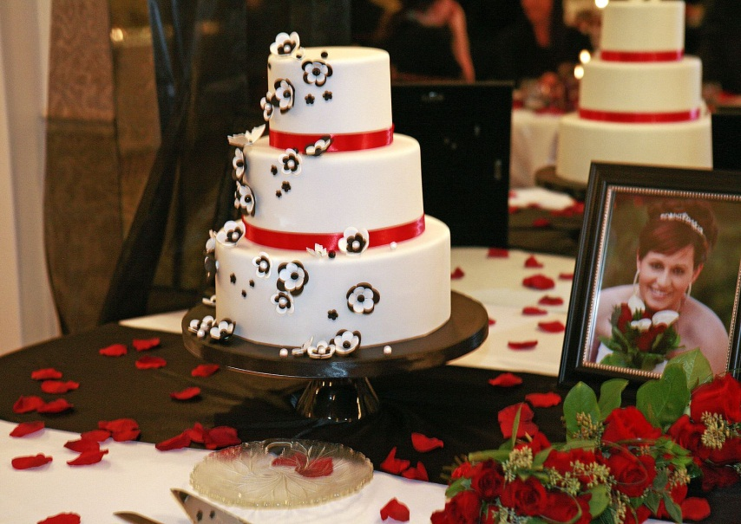

Slide 11
My homes
My husband and I purchased a house in Eagle Mountain. We stayed there for 18 months before he took a job in Kansas for 6 months. He just came back and we purchased our second home in Kaysville. (Our first home is still being rented out in Eagle Mountain).

Slide 12
Where I came from
I am the oldest of three children, in a functional family. My parents are still together and just had their 29th anniversary.
I am born and bred in Utah – I wouldn’t move away for anything!
I am a mix of everything from native american to swedish.

Slide 13
Where I am now
I am married, in my second home, with the loves of my life (my two dogs and my husband).
I am currently enrolled at SLCC obtaining my associates degree.
I work part time for the state of Utah (MVED) and love it.

Slide 14
Where I want to go in life
I want to have two children, obviously stay married to my husband, and live in Davis county for the rest of my life.
I want to graduate from the U or weber with a degree in English and Education. I would like to teach secondary level English.
I plan to get my masters in business after that.

Slide 15
Each of these events…
Every part of my life has taught me new things. I have been able to connect to my culture each time I learn about where my family came from. I enjoy driving through main street in bountiful and hearing the stories that my mother tells me about growing up and walking to the candy store.

Slide 16
Each of these events…
I love the feeling of the North Salt Lake/Bountiful area. The feeling of community and the attachment that I feel there is incredible. I enjoy volunteering to make it a better place. I hope to raise my children in this area one day, so they can feel the great sense of “home” that I feel each day.

Slide 17
Each of these events…
I believe that you begin to feel like a part of society when you are a productive member of your community. I cannot affect the entire society by myself, but I can start small and hope to affect others through a “ripple” effect.

